Slide 1

stream
Zhou Xianfeng

Slide 2
Agender
Review
Expand
Impliment stream

Slide 3
Expand
Writable
HTTP requests, on the client
HTTP responses, on the server
fs write streams
zlib streams
crypto streams
TCP sockets
child process stdin
process.stdout, process.stderr

Slide 4
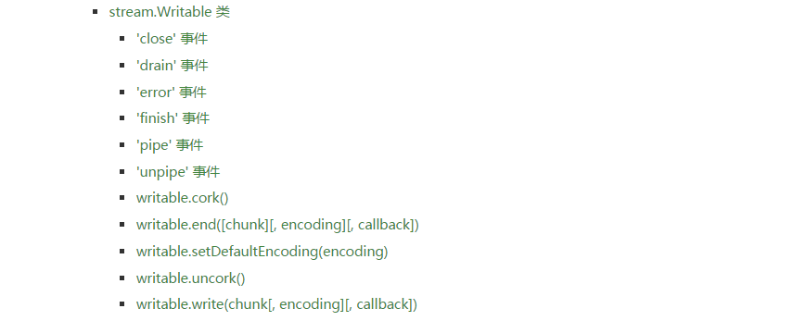
Expand

Slide 5
Expand
Readable
HTTP responses, on the client
HTTP requests, on the server
fs read streams
zlib streams
crypto streams
TCP sockets
child process stdout and stderr
process.stdin

Slide 6
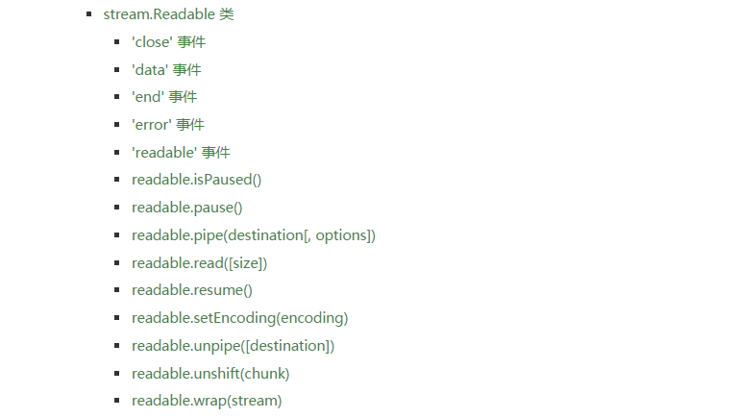
Expand

Slide 7
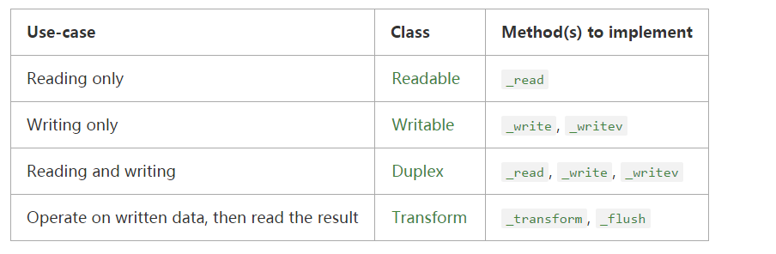
Impliment stream
The new stream class must then implement one or more specific methods, depending on the type of stream being created, as detailed in the chart below

Slide 8
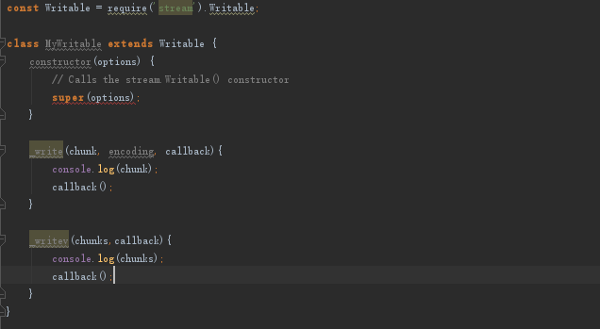
Impliment stream
writable

Slide 9
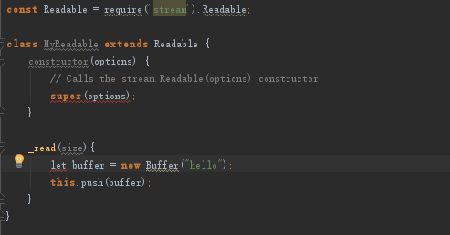
Impliment stream
readable

Slide 10
Thank You
Zhou Xianfeng

